Slide 1









FOOD
JOURNAL
Cheong Iok Cheong DC226373

Slide 2



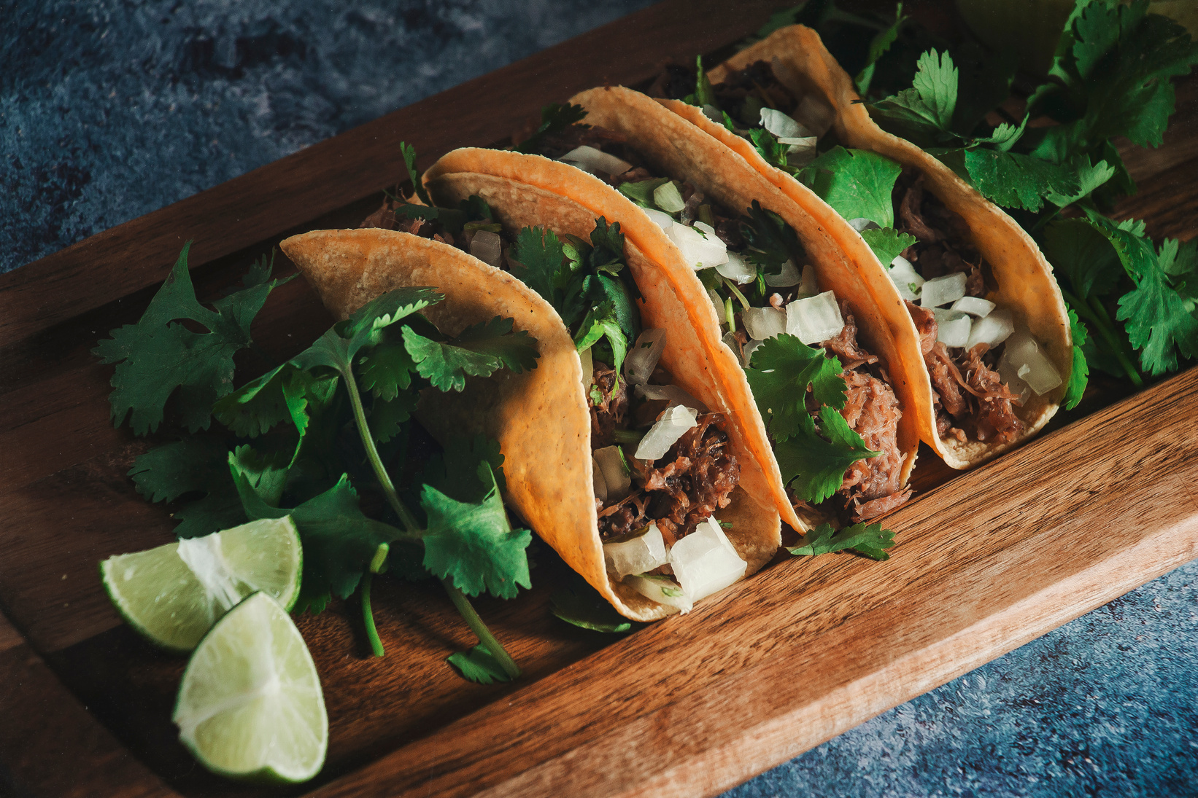


Introduction
Comprehensive food order system encompasses a login system, food management system, order system, and admin management system. The objective of this project was to create a user-friendly and efficient platform that streamlines the food ordering process, enhances customer experience, and facilitates effective administrative management in the food industry.

Slide 3




Objective
CENTRALIZE AND SIMPLIFY BACK-OFFICE MANAGEMENT
DRIVE OPERATIONAL EFFICIENCY AND DATA-DRIVEN DECISIONS
ENHANCE THE CUSTOMER EXPERIENCE

Slide 4







Function Design
ORDER SYSTEM
LOGIN SYSTEM
FOOD MANAGEMENT SYSTEM
ADMIN MANAGEMENT SYSTEM

Slide 5








Japan
Project Walkthrough
Italy
Mexico

Slide 6





Conclusion

Slide 7




THANK YOU
Let's continue to appreciate the culinary diversity of the world

